Slide 1

Introduction to Python
January 22, 2019
Mike Babb, Ph.C.
Department of Geography, UW

Slide 2
Why python?
It’s easy to jump in: https://www.python.org/about/gettingstarted/
It’s cross-platform: Windows, Mac, Linux
It was designed to be simple and readable: https://xkcd.com/353/
It’s free!
It’s popular: https://www.tiobe.com/tiobe-index/python/
It’s prolific: used in many industries for many jobs. Finance, real estate tech, server administration, health care research, non-profit administration
And departments across campus: sociology, economics, civil engineering, astronomy
Many libraries that do pretty much what you want with just a few commands

Slide 3
Brief history
Developed by Guido van Rossum in the early 90s. Current versions: Python 3.7.2 and Python 2.7.15
Python 3.7 is van Rossum’s (and the larger community’s) attempt at fixing some core issues with python 2.x
Integer division returns floats
Better handling of strings
Better memory management in some cases
It’s a bit faster in general: https://hackernoon.com/which-is-the-fastest-version-of-python-2ae7c61a6b2b

Slide 4
Activities
Examine basic python syntax
Using pandas, we will read in data pertaining to the age and sex of the population of Census Designated Places in Washington State during the 2013-2017 time period.
Compute the all-ages sex-ratio
Export the data to a .csv and an Excel workbook

Slide 5
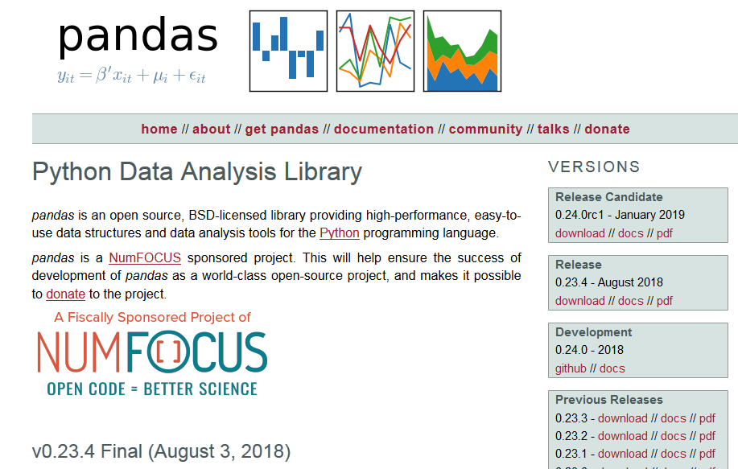
Pandas – Python Data Analysis Library
https://pandas.pydata.org/

Slide 6
Anaconda and the Jupyter Notebook
https://www.anaconda.com/
THE python data-science platform
Facilitates interactive python
Good for sharing and instruction
Easy to break code into manageable chunks

Slide 7
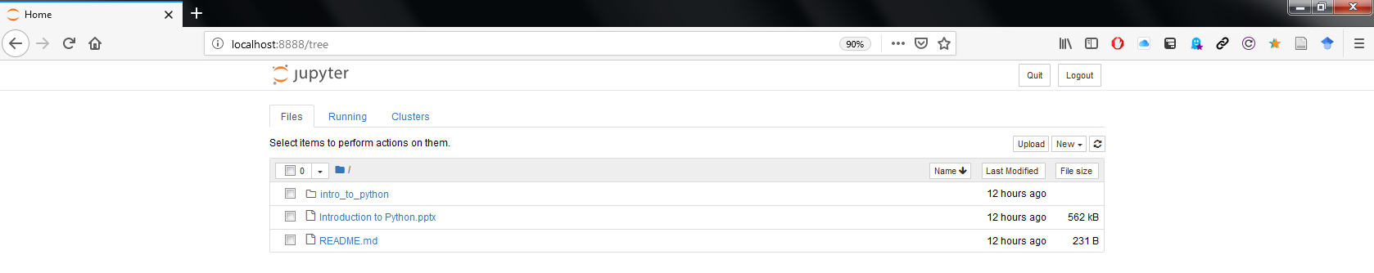
Jupyter Notebook Homepage

Slide 8
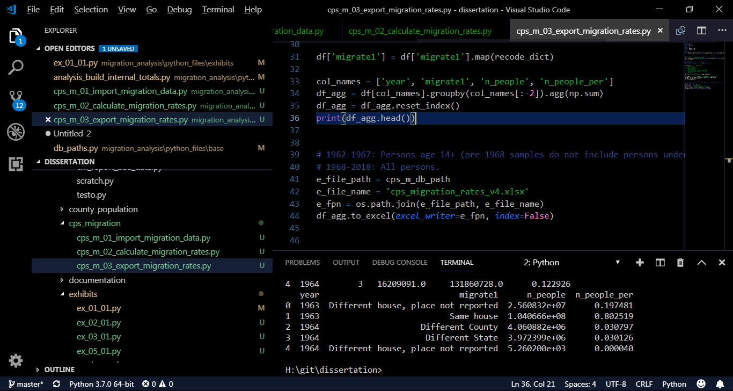
Python in… Visual studio Code

Slide 9
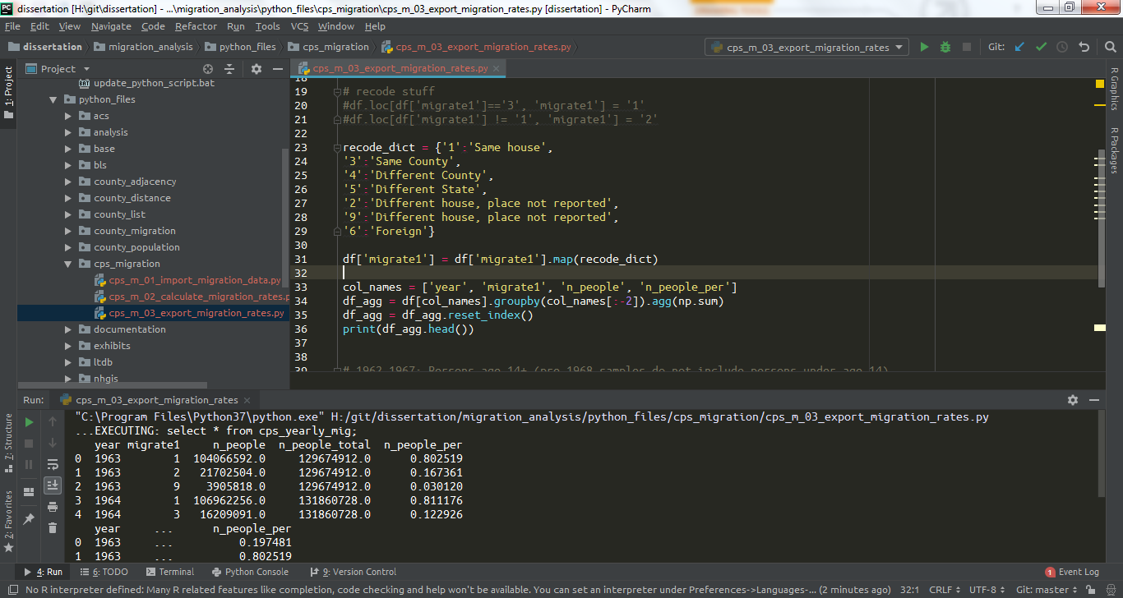
Python in… PyCharm

Slide 10
Finally… Python or R?
Both

